Slide 1
Course 609
Discounting and Climate Change
(in progress…)

Slide 2
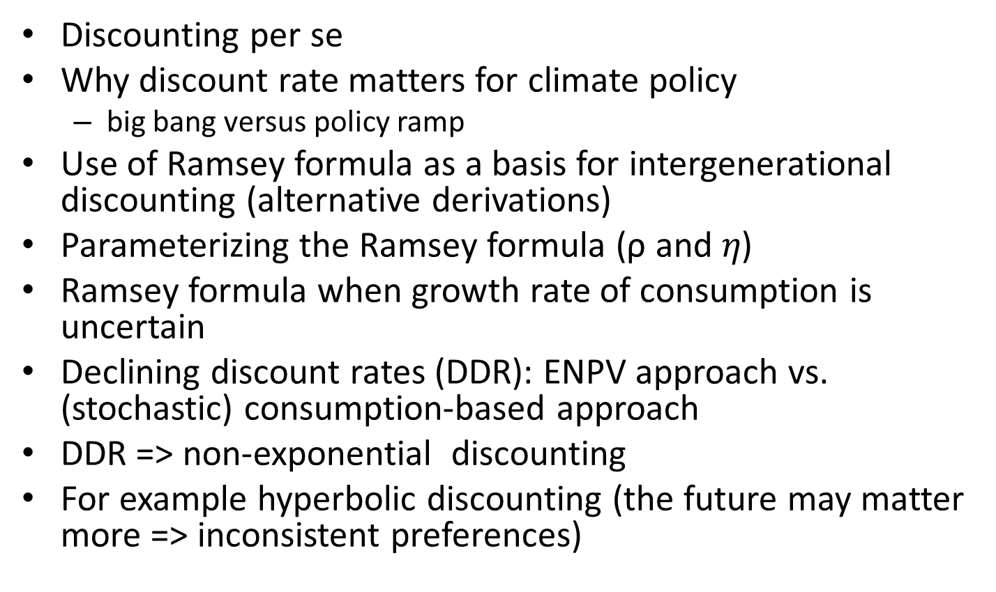
Outline
Discounting per se
Why discount rate matters for climate policy
  big bang versus policy ramp
Use of Ramsey formula as a basis for intergenerational discounting (alternative derivations)
Parameterizing the Ramsey formula (ρ and $η$)
Ramsey formula when growth rate of consumption is uncertain
Declining discount rates (DDR): ENPV approach vs. (stochastic) consumption-based approach
DDR => non-exponential discounting
For example hyperbolic discounting (the future may matter more => inconsistent preferences)

Slide 3
Discounting operates in the reverse direction of compunding.
While compounding measures how much present day investments will be worth in the future, discounting measures how much future benefits are worth today.
The higher the rate of discount, the greater the discrimination against future generations

Slide 4
The tyranny of the present (of the exponential law)
Discount Factor (DF)=

Slide 5
Social discount rate (SDR)
Defined as the appropriate value of r to use in computing present discount value for social investments/projects.
Used to measure social marginal cost & marginal benefit of I^{t}.
Determines whether project passes benefit-cost test.
Determining SDR not easy.
Error can lead to discrepancies in true net benefit of projects/policies.
Calculating true social marginal cost may be easier than measuring the social marginal benefit because of uncertainty involved in latter and they may last for long or occur in distant future (entails intergenerational discounting).
Small increase in SDR can matter enormously for long lived benefits or those far into the future.

Slide 6
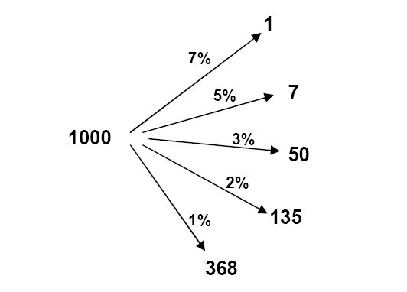
Example of discount rate
present value of $1000 after 100 years with different discount rates

Slide 7
Discount rate has an important effect on present value

Slide 8
Importance of discount rate in climate policy
Projects to reduce GHG emissions have long horizons.
Benefits last for centuries but mitigation costs borne today.
Whether such projects pass benefit-test is sensitive to rate at which future benefits are discounted.
Influence choice between ‘big bang’ vs. ‘policy ramp’ policies (rapid vs. gradual increase in emission control rates).
Stern/Weitzman vs. the rest (e.g., Nordhaus)

Slide 9
Positive or zero interest rate?
Some economists would argue against a positive pure time preference (delinked from economic issues) unless extinction of the human race is expected.
Pigou (1932): «our telescopic faculty is defective and we therefore see future pleasures as it were on a diminished scale.. It implies that people distribute the resources between the present, the near future and the remote future on the basis of a wholly irrational preference…the inevitable result is that efforts directed towards the future are starved relatively to efforts directed towards the present»
Harrod: «polite expression for rapacity and the conquest of reason by passion»
Ramsey (1928): «it is assumed that we do not discount later enjoyments in comparison with earlier ones, a practice which is ethically indefensible and arises merely from the weakness of the imagination»

Slide 10
Stern Review (2006)
Dire warning that global GDP at future risk of a 20% reduction if we fail to invest 1% of world GDP now to reduce global warming.
However, critics questioned the findings on the basis that they were arrived at using an extremely low discount rate of 1.4% used in economic modeling .
No consensus on SDR (Stern vs. Nordhaus vs. Weitzman).
Since there is a strong probability world will suffer significantly in the future due to global change in temperature, finding the correct social discount rate for the benefits of reducing CO2 emissions and other harmful greenhouse gases is very important.
Stern’s prtp (ρ) = 0.1% (one-tenth of 1%), that is, 0.001.
Non-zero rate justified on the basis of probability of extinction.

Slide 11
Ethics and climate change in the Stern Review
As compared with most previous economic analyses, the Stern Review recommended stronger and earlier mitigation action. It was explicit that this was largely driven by its ethical position, as reflected in the values used for the utility discount rate ρ and the elasticity of marginal utility η in the iso-elastic utility function.
Stern was criticised by a number of economists for using unreasonably low values for both ρ and η.
For ρ Stern took the prescriptive position and the extinction probability argument and used 0.001, giving more weight to future costs and benefits than many economists thought appropriate.
For η Stern used the value 1. Critics argued that this also gave too much weight to future, and richer, peoples’ utility. Stern conceded that higher values for η could be entertained, but that the implications of η > 2 were unacceptable.
Subsequent sensitivity analysis by the Stern Review team showed that increasing ρ to 0.0015 reduced the cost of doing nothing from a 10.9% to 3.1% reduction in global per capita consumption forever, while increasing η reduced it to 3.4%.
The team did not see any need to change the main conclusion in favour of strong early action on mitigation.

Slide 12
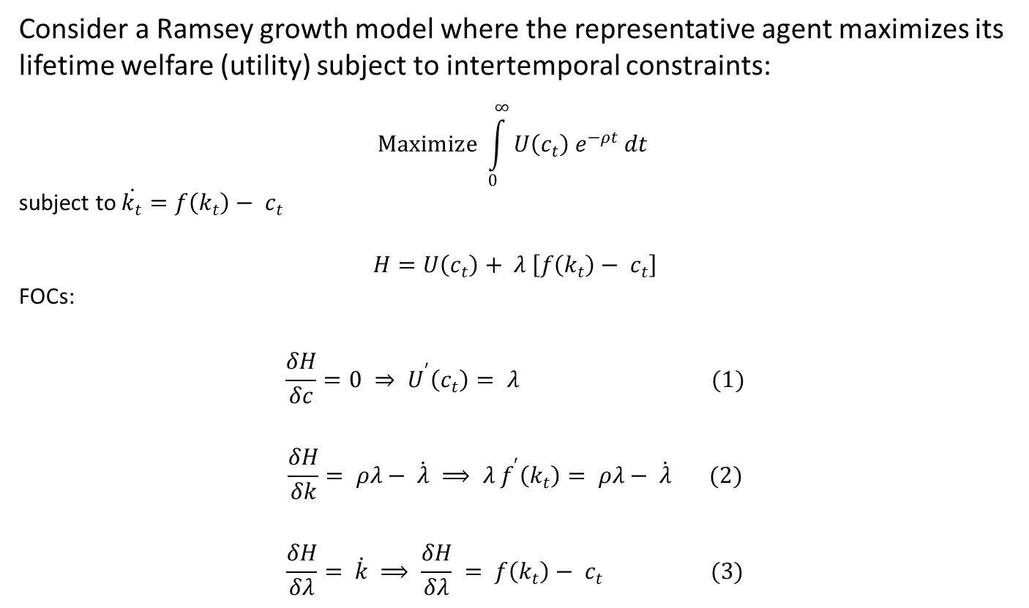
Calculating social discount rate using Ramsey rule
Consider a Ramsey growth model where the representative agent maximizes its lifetime welfare (utility) subject to intertemporal constraints:
$$Maximize \int_{0}^{∞}{U\left(c_{t}\right) e^{−ρt} dt}$$
subject to$\dot{k_{t}}=f\left(k_{t}\right)− c_{t}$
$$H=U\left(c_{t}\right)+ λ \left[f\left(k_{t}\right)− c_{t}\right]$$
FOCs:
$$\frac{δH}{δc}=0 ⇒ U^{′}\left(c_{t}\right)= λ (1)$$
$$\frac{δH}{δk}= ρλ− \dot{λ} ⟹ λ f^{′}\left(k_{t}\right)= ρλ− \dot{λ} (2)$$
$$\frac{δH}{δλ}= \dot{k} ⟹ \frac{δH}{δλ} = f\left(k_{t}\right)− c_{t} (3)$$

Slide 13

Calculating social discount rate using Ramsey rule
From (1)
$$\dot{λ}=U^{′′}\left(c_{t}\right)\dot{c} (4)$$
Substituting (1) in (2) and using (4)
$$U^{′}\left(c_{t}\right) f^{′}\left(k_{t}\right)= ρU^{′}\left(c_{t}\right)−U^{′′}\left(c_{t}\right)\dot{c}$$
$$U^{′}\left(c_{t}\right) f^{′}\left(k_{t}\right)+U^{′′}\left(c_{t}\right)\dot{c}−ρU^{′}\left(c_{t}\right)=0 (5)$$
…. [See handout]

Slide 14
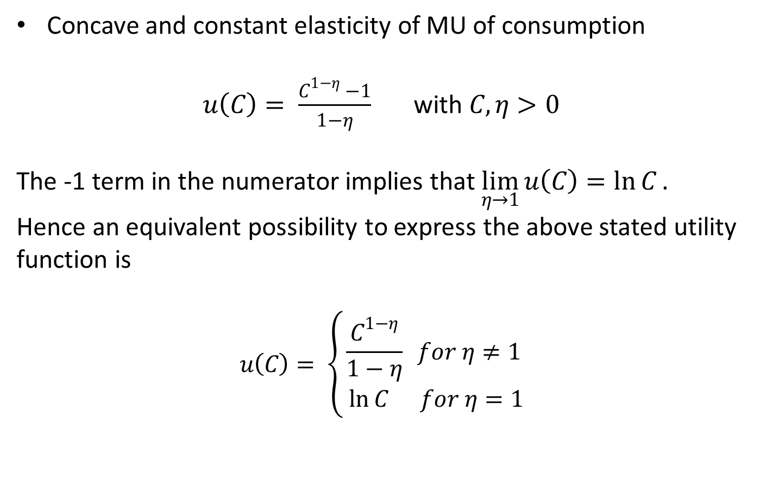
Utility function used in deriving Ramsey rule
Concave and constant elasticity of MU of consumption
$u\left(C\right)= \frac{C^{1−η} −1}{1−η}$ with $C,η>0$
The -1 term in the numerator implies that $\lim_{η→1}{u\left(C\right)=\ln{C}. }$ Hence an equivalent possibility to express the above stated utility function is
$$u\left(C\right)= \left\{\begin{aligned}\frac{C^{1−η}}{1−η} for η≠1 \\ \ln{C} for η=1\end{aligned}\right.$$

Slide 15
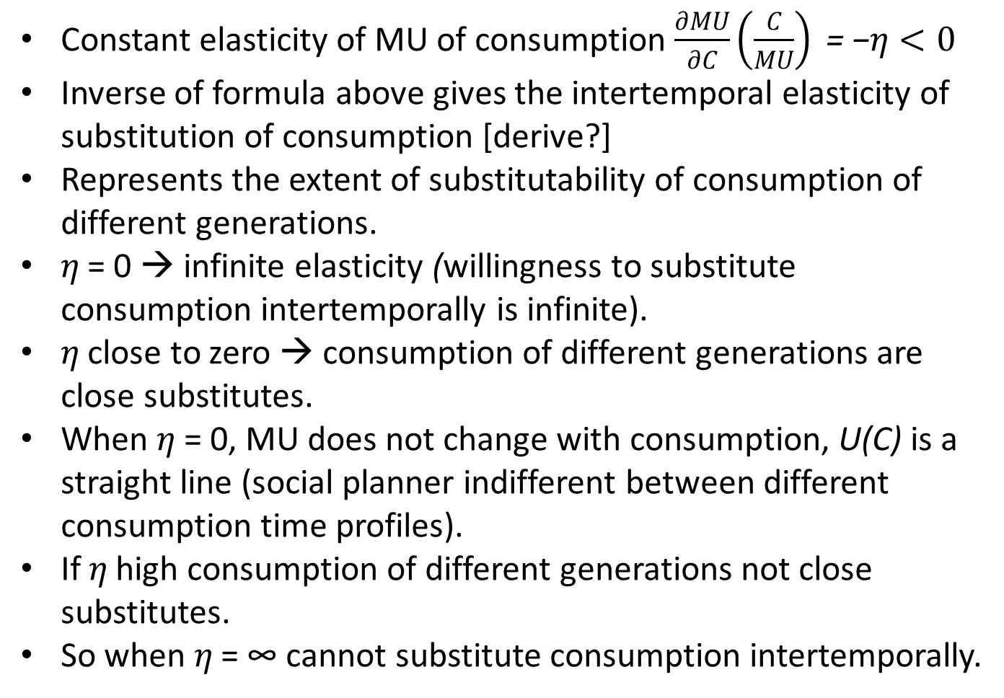
Utility function (CIES)
Constant elasticity of MU of consumption $\frac{∂MU}{∂C}\left(\frac{C}{MU}\right)\text{ =}\text{ −}η<0$
Inverse of formula above gives the intertemporal elasticity of substitution of consumption [derive?]
Represents the extent of substitutability of consumption of different generations.
$η$ = 0 → infinite elasticity (willingness to substitute consumption intertemporally is infinite).
$η$ close to zero → consumption of different generations are close substitutes.
When $η$ = 0, MU does not change with consumption, U(C) is a straight line (social planner indifferent between different consumption time profiles).
If $η$ high consumption of different generations not close substitutes.
So when $η$ = ∞ cannot substitute consumption intertemporally.

Slide 16
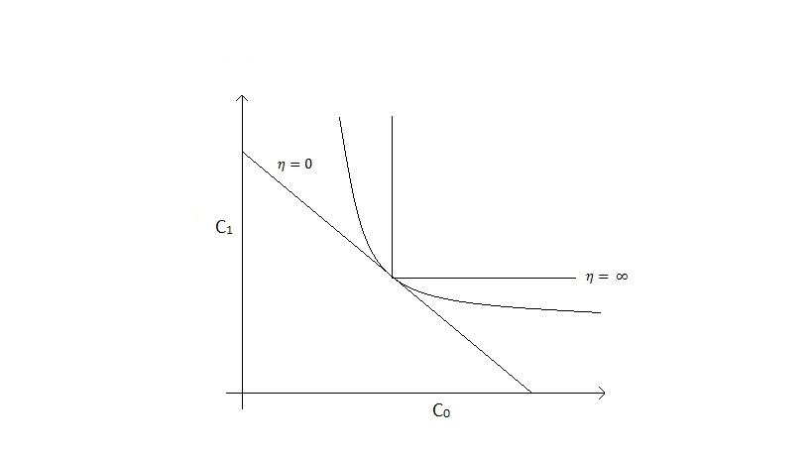

Slide 17
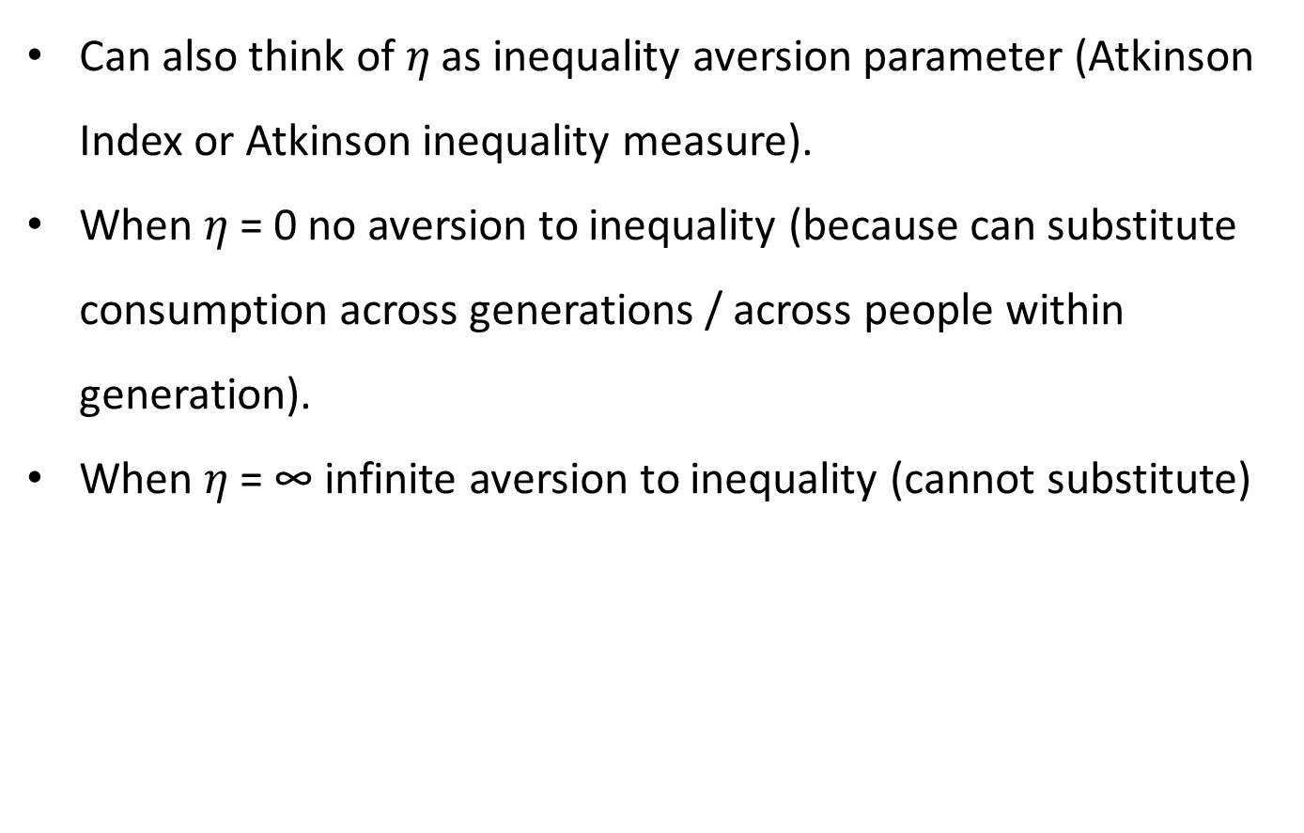
Inequality version (inter- or intra-generational)
Can also think of $η$ as inequality aversion parameter (Atkinson Index or Atkinson inequality measure).
When $η$ = 0 no aversion to inequality (because can substitute consumption across generations / across people within generation).
When $η$ = ∞ infinite aversion to inequality (cannot substitute)

Slide 18
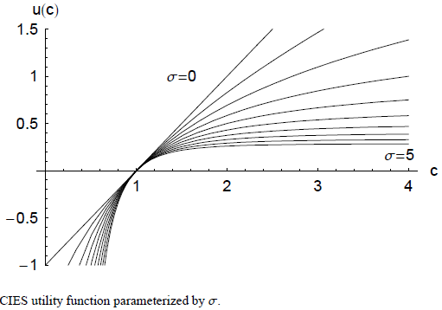
σ (= η) represents curvature of utility function

Slide 19
Social Discount Rate and Ramsey Rule (Euler Equation)
Social discount rate = ρ + (η x consumption growth rate, g)
Pure rate of time preference. Some suggest it should be 0 and with risk of human extinction perhaps 0.1%
Elasticity of marginal utility of consumption (some suggest this is 1, which assumes society is moderately adverse to income inequality).
Growth in per capita consumption varies over time and according to extent of climate change damages

Slide 20
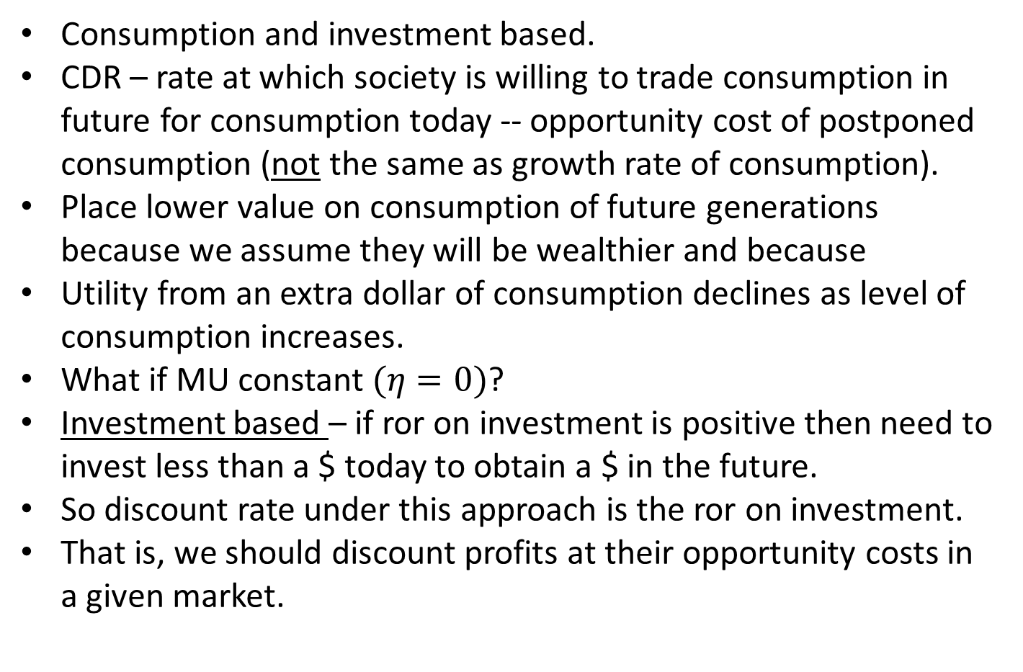
Two rationales for discounting
Consumption and investment based.
CDR – rate at which society is willing to trade consumption in future for consumption today -- opportunity cost of postponed consumption (not the same as growth rate of consumption).
Place lower value on consumption of future generations because we assume they will be wealthier and because
Utility from an extra dollar of consumption declines as level of consumption increases.
What if MU constant $(η=0)$?
Investment based – if ror on investment is positive then need to invest less than a $ today to obtain a $ in the future.
So discount rate under this approach is the ror on investment.
  That is, we should discount profits at their opportunity costs in a given market.

Slide 21
Declining discount rate (DDR)
Discount rate applied to costs and benefits declines over time
E.g., rate used to discount benefits from year 200 to year 100 is lower than the rate used to discount benefits in year 100 to the present (unlike constant exponential rate).
DDR used in France and UK – all benefits and costs in a given year are discounted at the same rate, but this rate declines over time (see fig.)
In US constant exponential rate (but different for inter- and intra-generational – CAFE standards discount reduced CO2 @ 2.5% and reduced fuel consumption @ 3% → different sources of benefits occurring in same year discounted to the present at different rates.
Example of DDR – hyperbolic discounting.

Slide 23
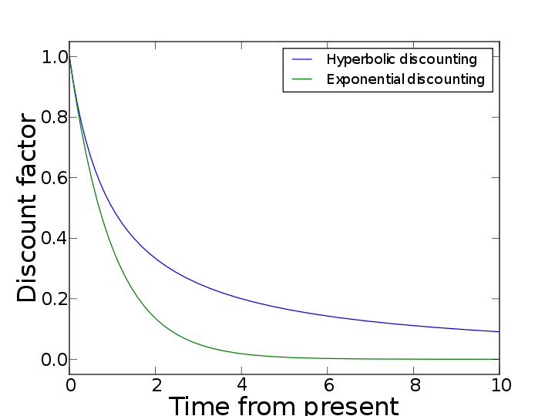

Slide 24
Two approaches to DDR
Expected net present value ENPV) approach (Weitzman 1998, 2001)
Consumption based approach (extended RR) Gollier (2012 ch.8, 2008).
ENPV → computing ENPV with an uncertain but constant discount rate is equivalent to computing the NPV with a certain but decreasing “certainty-equivalent” discount rate (see example)
The certainty equivalent discount rate is a sort of ‘implicit rate’

Slide 25
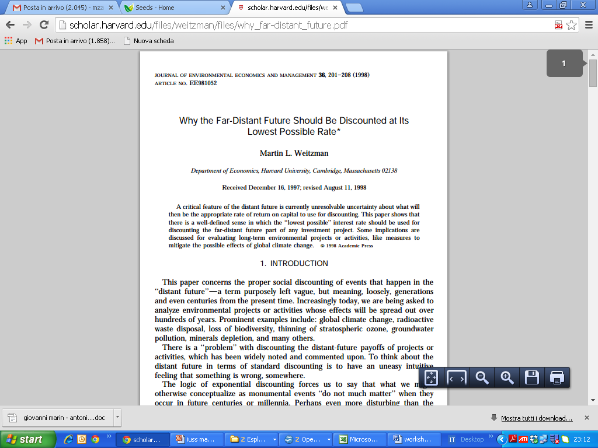
Il peso attribuito ai benefici netti per ogni periodo è dato dal discount factor:
che, con un tasso di sconto (r) costante, ha un andamento esponenziale che tende ad annullarsi con t che tende all’infinito.
Viste le implicazioni rilevanti sull’esito dell’analisi costi-benefici, la scelta del valore da attribuire al tasso di sconto necessita di basi teoriche ed empiriche solide.
Intuition:
uncertainty on future interest rates which occurr under different probabilistic state of the world
Discount Factor
r= interest rate

Slide 26
Example
Two states → A 5% (r_{A} = 0.05) and B (r_{B} = 0.08)
Average discount factor 6.5% (r_{μ(A,B)} = 0.065)
Investments of $1000 in 50 years with the two rates:
NPV_{A,50} = $1000/(1 + 0.05)⁵⁰ = $87.20
NPV_{B,50} = $1000/(1 + 0.08)⁵⁰ = $21.32
NPV calculated assuming the two states occur with equal probability = ½ is ENPV

Slide 27
ENPV₅₀ = (½)87.20 + (½)21.32 = $54.26
thus,
1000/(1 + r*)⁵⁰ = 54.26
r* is the certainty equivalent or implicit rate, the rate that gives the value of a lottery
so,
r* (implicit rate that associates with the certainty value) = (1000/54.26)^{1/50} − 1 = 6.00% < 6.50%
Notes:
se 1˙000/(1 + r*)⁵⁰ = 54.26 ⇒ (1 + r*)⁵⁰ = 1˙000/54.26 ⇒ r* = (1˙000/54.26)^{1/50} − 1 = 0.06.

Slide 28
The implicit rate differs from the ‘average rate’
Lets move from 50 to 55
With T = 55 we get
NPV_{A,55} = 1000/(1 + 0.05)⁵⁵ = $68.33
NPV_{B,55} = 1000/(1 + 0.08)⁵⁵ = $14.51
ENPV₅₅ = (½)68.33 + (½)14.51 = $41.43
1000/(1 + r*)⁵⁵ = 41.43 ⇒ r* = 5.96% < 6.0% (with T=50) < 6.5%

Slide 29
As T increases..
The distance between the implicit rate r* and the average rate augments.
The implicit rate r* - certainty equivalent discount rate decreases with T (formal proof relies on convexity of the discount factor and Jensen’s inequality).
This is DDR.

Slide 30
With seven states of possible r average is:
1%(1/7) + … + 7%(1/7) = 4.0012%
In this case
r*₁₀ = = 3.78907%
r*₁₀₀ = = 2.50215%
Uncertainty on r => decreasing implicit rates

Slide 31
Arrow et al. (Science 2013) Present value of a cash flow of $1000 received after t years
t | 1% | 4% | 7% | Equally likely 1% or 7% expected value | Certainty equivalent (%)
1 | 990.05 | 960.79 | 932.39 | 961.22 | 3.94
10 | 904.84 | 670.32 | 496.59 | 700.71 | 3.13
50 | 606.53 | 135.34 | 30.20 | 318.36 | 1.28
100 | 367.88 | 18.32 | 0.91 | 184.40 | 1.02
150 | 223.13 | 2.48 | 0.03 | 111.58 | 1.01
200 | 135.34 | 0.34 | 0.00 | 67.67 | 1.01
300 | 49.79 | 0.01 | 0.00 | 24.89 | 1.01
400 | 18.32 | 0.00 | 0.00 | 9.16 | 1.01

Slide 32
Pragmatic Weitzman like discounting
4% for costs-benefits in 1-5 years
3% for costs-benefits 6 -25 years
2% for costs-benefits 26 -75 years
1% for costs-benefits 76 -300 years
0% > 300 years
Weitzman, M. (2001), “Gamma Discounting”, AER 91(1):260-271

Slide 33
Approaching a floor which is very low, close to zero
For costs-benefits 300 years from now Weitzman assumes r = 0
The short term is discounted more

Slide 34
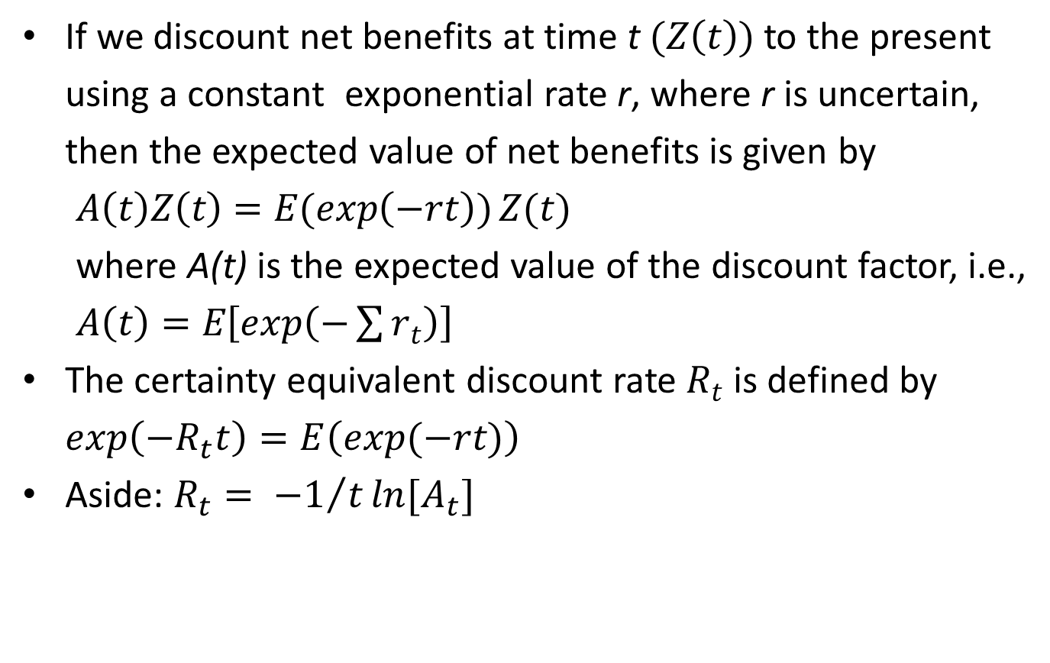
Formally defining “certainty equivalent” discount rate
(Arrow et al. 2014, Cropper et al. 2014)
If we discount net benefits at time t $(Z\left(t\right))$ to the present using a constant exponential rate r, where r is uncertain, then the expected value of net benefits is given by
$A\left(t\right)Z\left(t\right)=E(\exp\left(−rt\right))Z(t)$
where A(t) is the expected value of the discount factor, i.e.,
$A\left(t\right)=E\left[exp\left(−\sum{r_{t}}\right)\right]$
The certainty equivalent discount rate $R_{t}$ is defined by $\exp\left(−R_{t}t\right)=E\left(exp⁡(−rt)\right)$
Aside: $R_{t}= {−1}/tln⁡[A_{t}]$

Slide 35
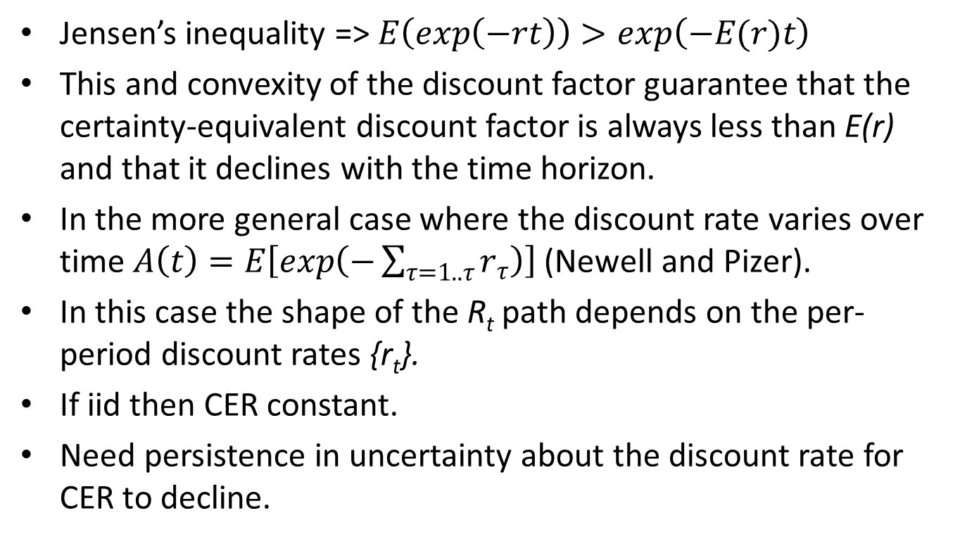
Jensen’s inequality => $E\left(\exp\left(−rt\right)\right)>exp\left(−E(r)t\right)$
This and convexity of the discount factor guarantee that the certainty-equivalent discount factor is always less than E(r) and that it declines with the time horizon.
In the more general case where the discount rate varies over time $A\left(t\right)=E\left[exp\left(−\sum_{τ=1..τ}{r_{τ}}\right)\right]$ (Newell and Pizer).
In this case the shape of the R_{t} path depends on the per-period discount rates {r_{t}}.
If iid then CER constant.
Need persistence in uncertainty about the discount rate for CER to decline.

Slide 36
